Slide 1
設備投資申請
投資内容
[Renewal] Nitrogen Generation System
1unit : MAE Assets
EUROPE AS BU
Minebea AccessSolution South America Ltda.
S32 -26027
1/8

Slide 2
July capital investment application（for orders placed in August 2026 ）
Title | [Renewal] Nitrogen Generation System - 1unit
Product name | Nitrogen Generation System
Customer | All Customers |  | Agree specification with customer: Not aplicable
Installation site | Minebea AccessSolutions South America. |  | This investment As planned or not planned
Purpose | New Product | Increase Production | Rationalization | Renewal・Other
Equipment maker (Purchase supplier) | ATLAS COPCO
Investment amount | 8,279 K-JPY - MAE Assets
Operation start | 2026/12
Payment term | 100% 30 days after equipment arrived at Guarulhos by cash
Payback period | Not applicable ※For reference: 1.9 years
Downside risk | No risk, because this equipment will be used in the Painting Area for all painting parts.
Investment background/Purpose Replace an old nitrogen generation system that has been operating since 2017 on the paint line, as it is no longer in working properly order and spare parts are unavailable for maintenance.
The reasons for investing now (Why can't it be postponed until next month?) There is a risk that the other four membranes will fail and render the equipment unusable. Currently two membranes are already inoperative.
Cost reduction process Total cost reduction：188 K-JPY(▲2.2%) Competitive quotations results Non- selected Maker： Plastic Solutions Reasons for selection Selected the lowest-cost equipment maker after considering quality, costs, delivery and maintenance support.
Cross- check results： Needs to be Completed by Facilities Division
2/8

Slide 3
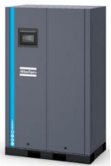
Overview (Product/purpose) 概要 製品/目的
Product name | Nitrogen Generator
Final customer | MAE Plant
Purpose of Use | Nitrogen Generator for painting system
Installed Model | GERADOR N2 – MEMBRANA - NGM35+ 230 IEC
Specifications / Performance | 36m³/h @ 99,5%; / 230V / ≤ -40 °C
GERADOR N2 – MEMBRANA - NGM35+ 230 IEC
The Nitrogen Generation System went into operation in 2017 and experienced a membrane failure in January 2026. We assess the need to replace the equipment during FY 2027, given that this nitrogen generator system has already reached its projected lifespan of 8 years.
Purpose overview:
Replace an old nitrogen generation system that has been operating since 2017 on the paint line, as it is no longer in working properly order and spare parts are unavailable for maintenance.
プロジェクト投資概要:
 | Currency K JPY |  |  | Investment amount | Collected amount | Margin | Margin % | Collection method | Expense accounting method
 | MAE asset | Nitrogen Generator | This Time | 8,279 | - | - | - | - | Depreciation 8 Years
 |  |  | Sub total | 8,279 | - | - | - | -
3/8

Slide 4
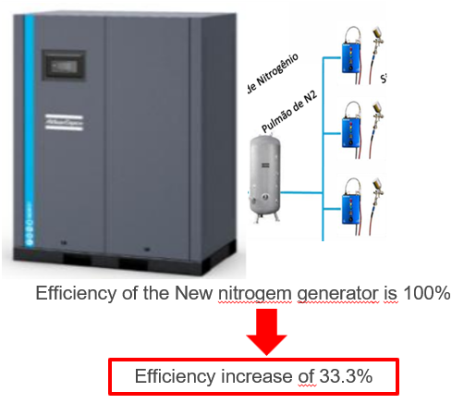
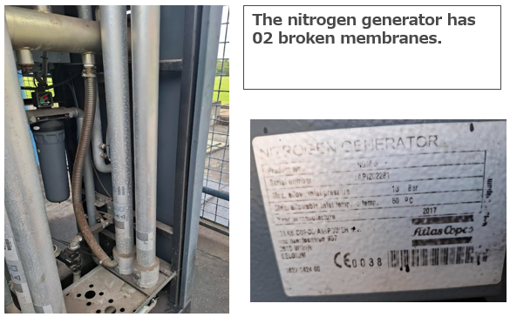
Overview (Product/purpose) 概要 製品/目的
CURRENT
AFTER
Current Situation :
The nitrogen generation system has 2 broken membranes.
Results: Loss of efficiency in nitrogen generation, leading to increased ink consumption.
Proposed Situation :
The nitrogen generation transforms compressed air from the compressor network into nitrogen gas with 99% purity for use in paint guns.
Results: Greater efficiency in nitrogen generation, resulting in reduced ink consumption.
4/8

Slide 5
Equipment installation schedule Nitrogen Generation System 設備導入計画
Nitrogen Generation System | Item | FY Mar.2027
 |  | Jun | Jul | Aug | Sep | Oct | Nov | Dec
 | CAPEX approval
 | Order
 | Equipment construction and delivery
 | Installation
 | Tests and adjustments
 | SOP (Guarulhos)
 | Payment: 100% 30 days after equipment arrived at Guarulhos by cash
5/8

Slide 6
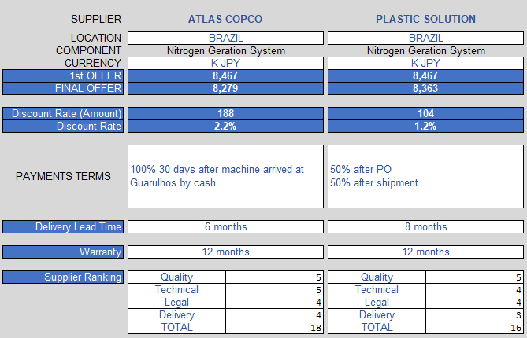
Price Discount Rate
< Reasons for selecting supplier >
We selected ATLAS COPCO as the supplier due to their competitive pricing, delivery and maintenance support
6/8

Slide 7

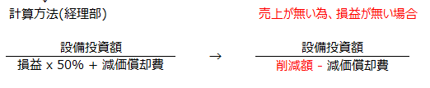
Pay Back Nitrogen Generation System
Impact of not using nitrogen Generation System :
■ Increased paint consumption due to the use of compressed air in paint guns.
Cost Avoidance Ink consumption | Saving by Year
 | 5,489 K-JPY
Total Investments | Nitrogen Generation System
 | 8,279 K-JPY
Formula for calculating the cost avoidance period
Installation Depreciation: 8 years
8,279 K-JPY
(5,489 K-JPY – (8,279 K-JPY / 8))
The return on investment of this project will be 1.9 years
7/8

Slide 8
以上、ご審議の程宜しくお願いいたします
Thanks for your attention
8/8

